Slide 1
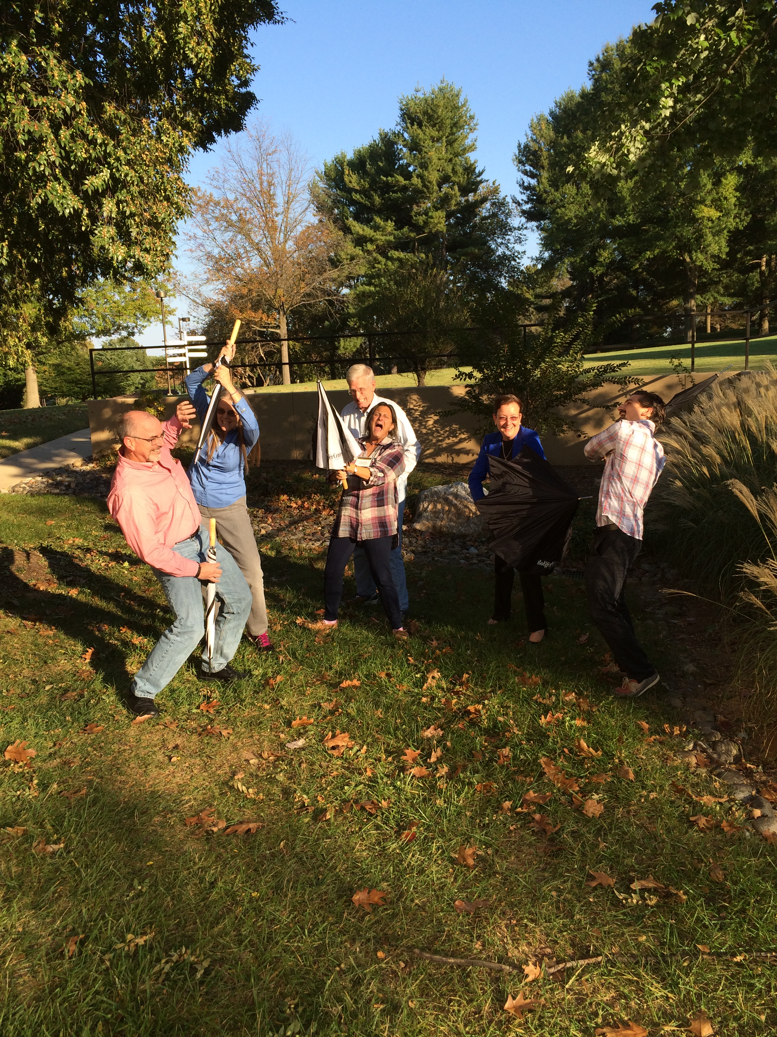
Pain, Distress and Humane Endpoints

Slide 2
Context
Module intended for seasoned IACUC members
This is part of a bigger training effort which would also cover:
USDA Pain Categories
Responsibility for each member to speak up regarding perspective about pain
Harm/Benefit analysis
Assess adequate consideration of alternatives

Slide 3
Goal
IACUC members recognize their role includes:
ensuring minimization of pain and distress; and
evaluating humane endpoints

Slide 4
Objectives
Define Pain and Distress
Recognize/rank procedures that could cause pain
Recognize procedures/situations that could cause distress
Define experimental and humane endpoints
Evaluate procedure for pain, distress and humane endpoints (IACUC role)
Recognize methods to manage pain and distress
Assess protocol which includes unrelieved pain and distress

Slide 5
Definitions provided at your table For upcoming exercises
Pain
Distress
Experimental Endpoint
Humane Endpoint

Slide 6
Rank procedures by potential to cause pain (high, medium, low)
Blood draw
Eye surgery
Laparoscopic Abdominal surgery
Bone repair
Cranial electrode implantation
8 mm skin punch biopsy
Ascites antibody production
Vaccination
Discuss in table groups (3 min) and determine consensus for voting
Notes:
Discuss in table groups (3 min) and determine consensus for voting

Slide 7
Distinguishing Pain versus Distress exercise
Pain
Distress
Discuss in groups: Do distributed procedures cause pain, distress, or both?
Notes:
Discuss in groups: Do distributed procedures cause pain, distress, or both?

Slide 8
Distinguishing Pain versus Distress exercise

Slide 9
Identifying humane Endpoint exercise
Consider:
Dr Potter submits a protocol in which she plans to inject colon tumor cells into nude mice in order to evaluate various dose levels of a new potent chemotherapeutic agent. What would be the humane endpoints to consider for this protocol?
Discuss and record (5min) at table, and report out to entire class

Slide 10
Methods to manage pain and distress
Think – Pair – Share
A. Brainstorm methods to manage pain and distress.
B. Which of the methods from A can be used when justification for withholding analgesics has been provided by the PI?
Not actually conducted – build a complete list through report out from the tables
Notes:
A list of pharmaceutical and non pharmaceutical methods will be available for instructors

Slide 11
Review Protocol as mock IACUC
NHPs are received and pair-housed during a period of quarantine. Once cleared quarantine and placed on protocol, animals are moved to a designated animal room and inoculated with virus. At 3 weeks time, animals become contagious and must be individually housed for a period of 6 – 8 weeks at which time they become debilitated with severe diarrhea and anorexia and do not recover
What should the IACUC consider before approving?
Each table serves as an IACUC, discuss in table group and report out (20 Min)

Slide 12
Summary
Define Pain and Distress
Recognize/rank procedures that could cause pain
Recognize procedures/situations that could cause distress
Define experimental and humane endpoints
Evaluate procedure for pain, distress and humane endpoints (IACUC role)
Recognize methods to manage pain and distress
Assess protocol which includes unrelieved pain and distress

Slide 13
Summative assessment
1. Match the attributes in the right column with the experiential states in the column on the left. Attributes may apply to one, both or neither of the experiential states.
Experiential States Attributes
____ Pain a. Consideration of intensity important in alleviation
____ Distress b. Is an issue even if minimal or transient
____ Both c. Is aversive
____ Neither d. If unrelieved, requires justification in some species.
e. Can be adaptive.
f. Can be alleviated by analgesics.
Notes:
Match the attributes in the right column with the experiential states in the column on the left. Attributes may apply to one, both or neither of the experiential states.
Experiential States Attributes
a,e,f Pain a. Consideration of intensity important in alleviation
____ Distress b. Is an issue even if minimal or transient
c,d_ Both c. Is aversive
b__ Neither d. If unrelieved, requires justification in some species.
e. Can be adaptive.
f. Can be alleviated by analgesics.

Slide 14
Summative assessment (continued)
2. Which of the following procedures would be considered painful (check all that apply)? __ Tail snip for mouse pup less than 7 days __ Dental extraction __ Percutaneous liver biopsy __ Blood draw __ Eye surgery
__ Chairing of nonhuman primate
Notes:
2. Which of the following procedures would be considered painful (check all that apply)? __ Tail snip for mouse pup less than 7 days _x_ Dental extraction _x_ Percutaneous liver biopsy __ Blood draw _x_ Eye surgery
__ Chairing of nonhuman primate

Slide 15
Summative assessment (Continued)
3. Which of the following procedures are likely to cause potential distress? All distressful procedures must be checked for the response to be considered correct.
___ Recording spontaneous running behavior in mice on an in-cage running wheel
___ A genetic defect in transgenic mice leads to adult onset weakness in the rear limbs that progresses to complete paralysis. Mice are euthanized when they lose the ability to right themselves or lose more than 25% of their baseline body weight.
___ Withdrawal of 5% of their circulating blood volume from a rabbit.
___ Housing a single non-human primate in a room by itself for veterinary care to prevent spread of an infectious disease.
___ Restraining a mouse to measure the size of a tumor implanted subcutaneously in the flank.
___ Withholding analgesia following surgery to create a model of rear limb pain because pain relieving drugs would invalidate the results of the study.
Notes:
3. Which of the following procedures are likely to cause potential distress? All distressful procedures must be checked for the response to be considered correct.
___ Recording spontaneous running behavior in mice on an in-cage running wheel
__x_ A genetic defect in transgenic mice leads to adult onset weakness in the rear limbs that progresses to complete paralysis. Mice are euthanized when they lose the ability to right themselves or lose more than 25% of their baseline body weight.
___ Withdrawal of 5% of their circulating blood volume from a rabbit.
__x_ Housing a single non-human primate in a room by itself for veterinary care to prevent spread of an infectious disease.
___ Restraining a mouse to measure the size of a tumor implanted subcutaneously in the flank.
_x__ Withholding analgesia following surgery to create a model of rear limb pain because pain relieving drugs would invalidate the results of the study.

Slide 16
Summative Assessment (Continued)
4. Consider the following scenario: Humane or Experimental Endpoints (Eugene)
Scenario A
PI Submits a protocol involving an Infectious disease animal model. As the disease progresses, the animal will experience significant pain and/or distress, which cannot be alleviated through the use of anesthesia or analgesia, as it would adversely affect the underlying physiological mechanism that the PI is studying. The PI states in the protocol that it is important that the disease progression will be evaluated until the point the animal is moribund with agonal respiration, at which it will be removed from study and euthanized. PI states that earlier endpoints could give rise to valid scientific concern.
This is an example of ____________________________ endpoints.
Scenario B
PI Submits a protocol involving an Infectious disease animal model. As the disease progresses, the animal will experience significant pain and/or distress, which cannot be alleviated through the use of anesthesia or analgesia, as it would adversely affect the underlying physiological mechanism that the PI is studying. The PI states in the protocol that it is important that the disease progression will be evaluated until the point the animal is moribund with agonal respiration, at which it will be removed from study and euthanized. PI states that earlier endpoints could give rise to valid scientific concern. The AV and IACUC require PI to amend endpoints to remove animal from study and euthanize when temperature has changed by 4 degrees C, Body weight loss is greater than 25 percent, animal is alert but unresponsive to stimulus.
This is an example of _____________________________ endpoints.
Notes:
4. Consider the following scenario: Humane or Experimental Endpoints
Scenario A
PI Submits a protocol involving an Infectious disease animal model. As the disease progresses, the animal will experience significant pain and/or distress, which cannot be alleviated through the use of anesthesia or analgesia, as it would adversely affect the underlying physiological mechanism that the PI is studying. The PI states in the protocol that it is important that the disease progression will be evaluated until the point the animal is moribund with agonal respiration, at which it will be removed from study and euthanized. PI states that earlier endpoints could give rise to valid scientific concern.
This is an example of __Experimental________________ endpoints.
Scenario B
PI Submits a protocol involving an Infectious disease animal model. As the disease progresses, the animal will experience significant pain and/or distress, which cannot be alleviated through the use of anesthesia or analgesia, as it would adversely affect the underlying physiological mechanism that the PI is studying. The PI states in the protocol that it is important that the disease progression will be evaluated until the point the animal is moribund with agonal respiration, at which it will be removed from study and euthanized. PI states that earlier endpoints could give rise to valid scientific concern. The AV and IACUC require PI to amend endpoints to remove animal from study and euthanize when temperature has changed by 4 degrees C, Body weight loss is greater than 25 percent, animal is alert but unresponsive to stimulus.
This is an example of ____Humane____________________ endpoints.

Slide 17
Summative assessment (continued)
5. Which of the following methods may help to manage pain and distress?
____ Quiet and/or dark recovery areas
____ Increased temperature of immediate surroundings
____ Soft bedding
____ Analgesics
____ Soft resting surface
____ Anti-inflammatories
____ Anesthetics
____ Paralytics
____ IV or IP fluid administration
____ Highly palatable food or treats
____ Placement of food in close proximity for easier access (e.g. on floor of cage)
____ Tranquilizers
Notes:
5. Which of the following methods may help to manage pain and distress? (all but paralytics)
____ Quiet and/or dark recovery areas
____ Increased temperature of immediate surroundings
____ Soft bedding
____ Analgesics
____ Soft resting surface
____ Anti-inflammatories
____ Anesthetics
____ Paralytics
____ IV or IP fluid administration
____ Highly palatable food or treats
____ Placement of food in close proximity for easier access (e.g. on floor of cage)
____ Tranquilizers

Slide 18
Summative Assessment (Continued)
6. What factors should be covered in an adequate scientific justification for a painful or distressful procedure?
Dr. Potter has submitted a protocol to the IACUC in which she proposes to develop a mouse model to study Ebola virus infection by transplanting human hematopoietic stem cells into an immune-compromised mouse strain. If this transplantation is successful, most of the mice will develop an Ebola infection and succumb to the disease, which produces cell damage, liver steatosis and high mortality. The mice are allowed to progress to full-blown disease so that the similarity to the human disease can be documented, and further studies can proceed to develop a successful vaccine.
Please describe the factors that should be considered when reviewing this protocol, which if approved, would result in unrelieved pain/distress to the mice.
Notes:
6. What factors should be covered in an adequate scientific justification for a painful or distressful procedure?
Dr. Potter has submitted a protocol to the IACUC in which she proposes to develop a mouse model to study Ebola virus infection by transplanting human hematopoietic stem cells into an immune-compromised mouse strain. If this transplantation is successful, most of the mice will develop an Ebola infection and succumb to the disease, which produces cell damage, liver steatosis and high mortality. The mice are allowed to progress to full-blown disease so that the similarity to the human disease can be documented, and further studies can proceed to develop a successful vaccine.
Please describe the factors that should be considered when reviewing this protocol, which if approved, would result in unrelieved pain/distress to the mice.
Response:
Consideration of the 3Rs: Can a less sentient species be used, or can this study be done in a human cell culture system? Since this is a preliminary study, can the number of mice be minimized in order to confirm the validity of the model? Since the mice must be kept alive to determine if they will develop a human-like full-blown response to the virus, can their pain/distress be mitigated by non-pharmacological means?
Analyze the cost/benefit of the study. Ebola is a highly lethal disease that causes significant pain to the animals, but is a serious human health threat. If the model successfully models the human disease, it may produce useful information to combat the disease in human populations. However, since this is a pilot study, the number of animals should be minimized until the model is shown to be translatable to the human disease.
How will unrelieved pain/distress confound the results of the study?

Slide 19
Humane endpoint – No Animals were Harmed!
Jim
Nora
Brent
Joanne
Mary Lou
Eugene

